Slide 1


Slide 2


Alieh Ghasemzadeh,Md
Professor
Tabriz university of medical sciences
a

Slide 3
Definition
Polycystic ovary syndrome (PCOS) is the most common endocrine condition affecting between 8 and 13% of women of reproductive age and 6–18% of adolescent girls depending on the diagnostic criteria used and the population studied .Adolescence, as defined by the World Health Organisation, is the period between 10 and 19 years of age that includes significant and critical changes in growth, development and puberty.

Slide 4
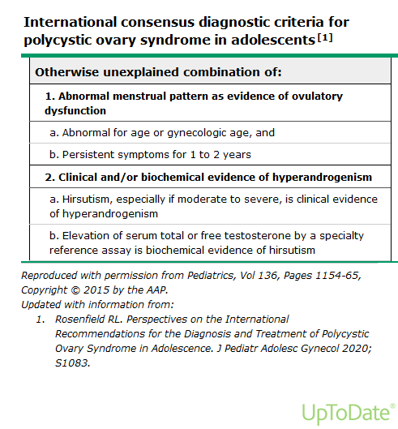

Slide 5
Polycystic ovary syndrome (PCOS) should be considered in any adolescent girl with a chief complaint of hirsutism, menstrual irregularity, or obesity. Acanthosis nigricans, treatment-resistant acne, scalp hair loss, or hyperhidrosis may alternatively be the chief complaint, although these features are not always present.

Slide 6
Clinical life long implications of PCOS
increased risk for metabolic syndrome
type 2 diabetes mellitus
cardiovascular disease
endometrial carcinoma
The cause of PCOS is unknown. Considerable evidence suggests that it arises as a complex trait with contributions from both heritable and nonheritable intrauterine and extrauterine factors. Functional ovarian hyperandrogenism is usually the major source of the androgen excess and can account for the major features of the syndrome (ie, hirsutism, anovulation, and polycystic ovaries)

Slide 7


Slide 8
Diagnostic criteria for PCOS in adults have been problematic when applied to adolescents, for several reasons:
1-Anovulatory cycles and associated menstrual irregularity are frequent in normal adolescents.
2-The common signs of hyperandrogenism in adults are less reliable when applied to adolescents because hirsutism is in a developmental phase and acne vulgaris is common.
3-Measurement of testosterone concentrations in adolescents is problematic because serum concentrations rise during anovulatory cycles.
4- Polycystic ovary morphology by adult standards is common in normal adolescents.

Slide 9
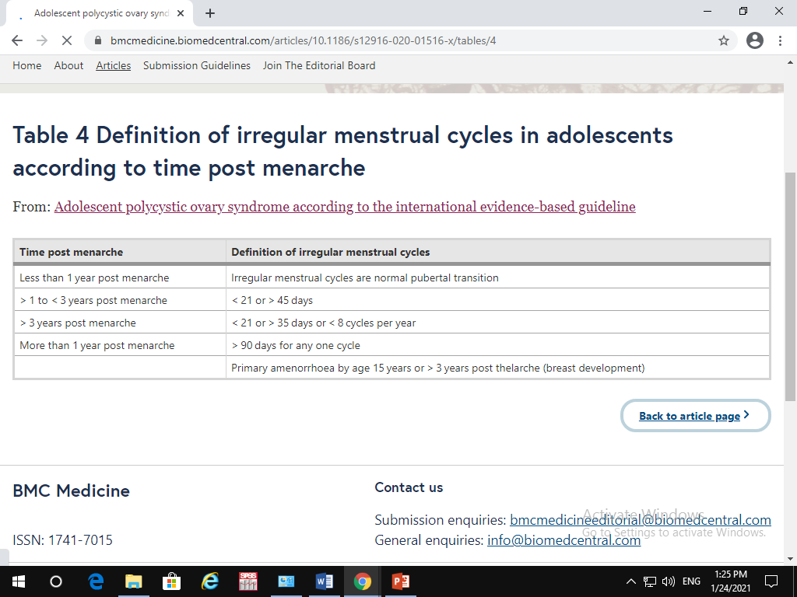

Slide 10
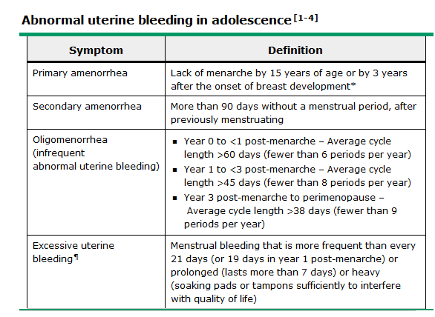

Slide 11
Ultrasonography
Ultrasonography is not recommended for the diagnosis of PCOS. ovarian and adrenal ultrasonography (exclude rare but serious androgen-producing tumors)
ultrasonography only for selected patients with features that are atypical for PCOS, such as very high testosterone levels (eg, >150 ng/dL), clitoromegaly, rapidly progressive hirsutism, or poor response to treatment.
By high-definition vaginal imaging small antral follicle counts up to 24 are normal.
ovarian volume >12 mL =PCOM in adolescence
However, ovarian volume up to 14 mL was the median of normal adolescents.

Slide 12
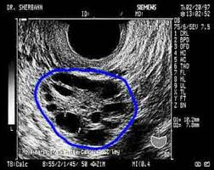
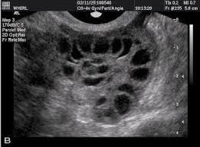

Slide 13
CLINICAL FEATURES
hirsutism
topical treatment-resistant acne,
menstrual irregularities(hyper hyperandrogenic anovulation)
acanthosis nigricans(1/3 before menstrual irregularities )
and/or obesity(1/2)

Slide 14
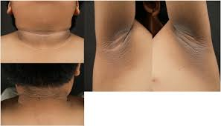

Slide 15
Cutaneous manifestations of hyperandrogenism
Hirsutism — abnormal amount of sexual hair that appears in a male pattern graded by Ferriman-Gallwey system,. Sexual hair growth matures throughout puberty to achieve maturity by two years after menarche, at approximately 15 years of age.
The normal score varies with ethnicity: Hirsutism is defined in Mediterranean populations as a score ≥9 to 10.
Localized areas of excessive sexual hair growth ("focal hirsutism") with a normal score is a common cosmetic complaint.

Slide 16
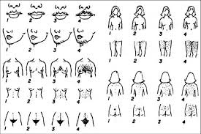

Slide 17
Hypertrichosis
the generalized excess growth of vellus hair on a hereditary basis or in patients taking drugs:
glucocorticoids
phenytoin
diazoxide
cyclosporine.
It has nonsexual pattern (eg, generalized distribution or more prominent distribution on the forehead or shoulders) and is not caused by excess androgen, although it may be aggravated by excess androgen)

Slide 18
Because one-half of the cases of mild hirsutism are due to idiopathic hirsutism, adolescent PCOS guidelines consider only moderate to severe hirsutism to constitute clinical evidence of hyperandrogenism and also consider even this to be less reliable evidence of hyperandrogenism than persistent testosterone elevation determined by a reliable reference assay.

Slide 19
Acne
Excessive acne vulgaris is an important, cutaneous manifestation of hyperandrogenemia in adolescents . Comedonal acne is common in adolescent girls, the presence of moderate (>10 facial lesions) or severe inflammatory acne through the perimenarcheal years suggests hyperandrogenemia .
Such patients are often prescribed hormonal therapy for their acne, which suppresses androgen levels .
Thus, moderate to severe inflammatory acne vulgaris that is persistent and poorly responsive to topical or oral antibiotic treatment is an indication to test for hyperandrogenemia .

Slide 20
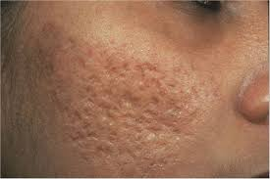
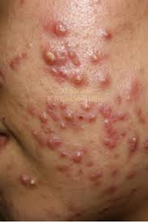

Slide 21
Balding
male pattern (fronto-temporo-occipital scalp)
female pattern (affecting the crown, typically manifesting early as a midline part widened in a "Christmas tree" pattern) . Alternate cutaneous manifestations of hyperandrogenemia ("hirsutism equivalents"), like hirsutism and acne, are also variably expressed. They include seborrhea, hyperhidrosis, and hidradenitis suppurativa . Hidradenitis suppurativa is characterized by painful inflammatory nodules in intertriginous areas, particularly the axillae.

Slide 22
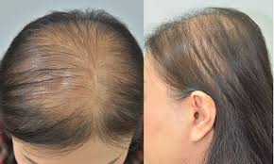
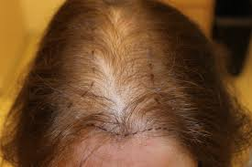
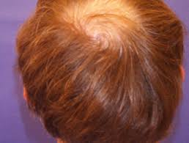
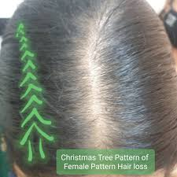

Slide 23
BASIC DIAGNOSTIC APPROACH
History and physical examination
Testing for hyperandrogenemia
Considerations for testosterone assays
Total testosterone(normal upper limit in adult women 40 to 60 ng/dL)
The serum free testosterone concentration
Beta HCG
Chronic disease panel
Follicle-stimulating hormone (FSH) and luteinizing hormone (LH)
Prolactin
TSH

Slide 24
Endocrine screening panel
17-hydroxyprogesterone (Early-morning 17OHP)
DHEAS is included primarily to screen for an adrenal tumor
Serum cortisol –optional test
a serum cortisol concentration of <10 mcg/dL (276 nmol/L) is reassuring evidence against endogenous Cushing syndrome
Insulin-like growth factor 1 (IGF-1) in special conditions
Ultrasonography

Slide 25
Sampling for 17oh progesterone
during amenorrhea
1-10 days of a menstrual cycle in regularly cycling patients (17OHP rises during the preovulatory and luteal phases). 17OHP value of >170 ng/dL is suggestive of NCCAH in an anovulatory cycle but is also compatible with recent ovulation. (>20 percent of patients with PCOS have elevated baseline 17OHP concentrations, as do some with tumoral hyperandrogenism) .An abnormal screening test is not diagnostic but requires a cosyntropin (ACTH) stimulation test to confirm the diagnosis of CAH ,unless the basal 17OHP level is >1000 ng/dL (30 nmol/L)

Slide 26
measure serum progesterone at the same time as the 17OHP measurement to rule out the possibility that the patient has unexpectedly ovulated (which occurs in 10 percent of oligo-amenorrheic PCOS patients) and is unknowingly being tested in the luteal phase of her cycle. The luteal phase is indicated by a serum progesterone >175 ng/dL (5.5 nmol/L) and can be accompanied by 17OHP levels up to 350 ng/dL (10.5 nmol/L).

Slide 27
Ovarian findings
Anovulation —
abnormal and physiologic anovulation
Cycles shorter than 19 days or longer than 90 days are abnormal at any stage
75 percent of menstrual cycles range from 21 to 45 days during the first postmenarcheal (gynecologic) year, and 95 percent of girls achieve 21- to 38-day adult menstrual cyclicity by their fourth gynecologic year.

Slide 28
In summary, uterine bleeding at intervals more frequent than every 19 days or less frequent than every 90 days is abnormal.
In the absence of clinical evidence of an endocrine disorder, a menstrual abnormality that goes on for one year has approximately a 50 percent probability of persisting and approximately one-half of the ongoing cases will have PCOS. Lengthier persistence progressively increases the likelihood of an underlying anovulatory disorder. Clinical evidence of hyperandrogenism such as hirsutism increases the risk of PCOS.

Slide 29
"at-risk for PCOS"
The international guidelines have urged caution before labeling hyperandrogenic adolescents as having PCOS if the menstrual abnormality has not persisted for one to two years. Prior to that point in time, they recommend that such girls be assigned the provisional diagnosis "at-risk for PCOS" to avoid misdiagnosing physiologic pubertal changes as PCOS. longitudinal reevaluation leeds to higher value on the accuracy of diagnosis than on early diagnosis.
Ultrasonographic criteria for polycystic ovary morphology (PCOM) the presence of clear PCOM, in combination with symptomatic hyperandrogenism in the absence of anovulatory symptoms, poses a risk for PCOS in an adolescent careful follow-up of these girls .

Slide 30
Delay diagnosis
earlier diagnostic testing {if a ocp or other treatment is indicated to regulate menstrual cyclicity or to treat comorbidities suggestive of PCOS (eg, development of hirsutism, moderate inflammatory acne resistant to topical therapy, and acanthosis nigricans}. Androgen-suppressive treatment will delay diagnosis, which also delays control of symptoms and increases the risk of developing endometrial hyperplasia and carcinoma . Occasionally, excessive uterine bleeding may mandate emergency evaluation early in the course. Primary amenorrhea should be evaluated when recognized.

Slide 31
longitudinal reevaluation
adolescents in whom a provisional diagnosis of PCOS has been made, withdrawing the combined oral contraceptive for approximately three months when the patient is gynecologically mature (eg, upon graduation from high school) to determine persistence of hyperandrogenic anovulation(contraceptive counseling because the infertility of PCOS is relative, not absolute.)
While PCOS often begins during adolescence, it sometimes cannot be definitively diagnosed, because the menstrual abnormality may not become apparent until three or more years after the onset of menarche.

Slide 32
FAMILY EVALUATION
Because of the high frequency of PCOS and metabolic syndrome among immediate relatives of individuals with PCOS, we recommend screening for features of metabolic syndrome and for diabetes mellitus in immediate family members of both sexes, particularly in those who are obese, and for features of PCOS in those females who are premenopausal. In particular, we suggest screening the overweight or obese parents of women with PCOS for diabetes because only approximately one-half of the parents with diabetes are symptomatic at the time their daughter is diagnosed with PCOS.

Slide 33
Associated metabolic features
Obesity and clinical manifestations of insulin resistance are strongly associated with PCOS . PCOS is the most common obesity-related endocrine syndrome in females
The clinical manifestations of insulin resistance :
1- acanthosis nigricans,
2-metabolic syndrome It refers to the co-occurrence of metabolic risk factors for type 2 diabetes and cardiovascular disease, including abdominal obesity, hyperglycemia, elevated triglycerides, low HDL, and hypertension. There is not yet consensus about the critical levels necessary for the diagnosis in adolescent,
3-sleep-disordered breathing (SDB)
4-nonalcoholic fatty liver disease(fat and hyperandrogenism)

Slide 34
Psychological issues
Depressive symptoms and anxiety
Distress with body appearance
Disordered eating
Autism spectrum disorders
and that their offspring also have an increased prevalence of autism spectrum disorders along with attention deficit hyperactivity disorder.

Slide 35
DIFFERENTIAL DIAGNOSIS
1-Physiologic adolescent anovulation
2-Virilizing congenital adrenal hyperplasia (CAH)
3-Related congenital disorders of adrenal steroid metabolism or action
4-Cushing syndrome
5-Virilizing tumors
6-Ovarian steroidogenic blocks
7-Hyperprolactinemia
8-Insulin-resistance disorders
9-Acromegaly
10-Thyroid dysfunction
11-Drugs
12-Other causes
13-Idiopathic hyperandrogenism

Slide 36
Treatment for PCOS in adolescents
primarily symptomatic and directed at the major clinical manifestations, which are:
●Abnormal uterine bleeding – Menstrual irregularity or excessive bleeding
●Cutaneous hyperandrogenism – Primarily hirsutism and persistent acne
●Obesity and insulin resistance

Slide 37
Menstrual irregularity
Menstrual irregularity should be treated in adolescents with PCOS, not only for psychosocial reasons, but because chronic anovulation increases the risk of developing endometrial hyperplasia, which is associated with endometrial carcinoma. Progestin is the critical ingredient in COCs that inhibits endometrial proliferation; it prevents the hyperplasia that results from unopposed estrogen action.
OCP(no diffetence in efficacy)
PROGESTINS

Slide 38
Excessive menstrual bleeding
Excessive irregular menstrual bleeding due to ovulatory dysfunction is a common manifestation of PCOS and often is the initial presenting complaint .Heavy uterine bleeding can cause anemia of a critical degree. COCs or progestin-only regimens are usually effective in managing this symptom.

Slide 39
Menstrual abnormalities
usually can be controlled within one to two months of starting COC treatment, in our experience. COC therapy will normalize androgen levels within 18 to 21 days. We suggest rechecking serum free testosterone late in the third cycle of COC treatment. Because of escape from ovarian suppression during the pill-free interval, exceptional patients require an extended cycle COC to control severe hyperandrogenemia.

Slide 40
In general, we suggest selecting a COC that contains at least 30 mcg ethinyl estradiol, unless the adolescent is at risk for COC side effects .This is because COCs containing ≤20 mcg ethinyl estradiol, though posing little cardiovascular risk, may inadequately promote normal accrual of bone mass and may be less effective in controlling irregular menstrual bleeding, particularly in obese hyperandrogenic girls, than those containing 30 to 35 mcg ethinyl estradiol.

Slide 41
Treatment of heavy menstrual bleeding is similar in adolescents with or without PCOS. The estrogen doses required to treat excessive abnormal uterine bleeding may be three- to fourfold higher than the doses needed to treat irregular menses .Once active bleeding is controlled, therapy with cyclic COC or progestin should be started to prevent recurrence of abnormal uterine bleeding

Slide 42
Optimal duration
Whereas PCOS ordinarily persists, little is known about the natural history of PCOS diagnosed in adolescence, particularly in mild cases.
Continue treatment until the patient is gynecologically mature (five years postmenarcheal) or has
lost a substantial amount of excess weight if obesity is a coexisting condition.
Management of PCOS in adolescents also includes evaluation of first-degree relatives because the hyperandrogenism and metabolic components of the syndrome have familial elements.

Slide 43
Combination oral contraceptives
COCs, first-line treatment for adolescents with PCOS and abnormal menstrual bleeding or cutaneous signs of androgen excess. In general, we suggest selecting a COC that contains at least 30 mcg ethinyl estradiol, unless the adolescent is at risk for COC side effects. COCs may carry a more deleterious metabolic risk profile in obese women with PCOS than those without PCOS .For this reason, we ordinarily use a COC that has a progestin with antiandrogenic or minimal androgenic activity.

Slide 44
Progestins
Menstrual irregularities in sexually mature adolescents often can be controlled with cyclic progestin alone. Cyclic progestin is particularly useful in younger patients with menstrual irregularity but without clinical evidence of hyperandrogenism, before the diagnosis of PCOS can be established. It is also useful when there are contraindications or patient objections to estrogen-containing COCs.

Slide 45
Micronized progesterone (uterogesan 100 to 200 mg given orally at bedtime) or medroxyprogesterone acetate (DMPA; Provera, 10 mg given orally at bedtime) for 7 to 10 days out of each month or cycle.
Progesterone itself confers no risk for cardiovascular disease or breast cancer and may lessen the small estrogen-related increase in risk in premenopausal women .
Progestin therapy in a six-week cycle can permit the detection of the emergence of normal menstrual cyclicity. As an example, the perimenarcheal girl who responds well to progestin therapy can be maintained on six-week cycles, permitting the detection of spontaneous menses.

Slide 46
Side effects of progestin
mood symptoms (eg, depression)
bloating
and breast soreness
Patients must be informed that oral progestin prescribed to regulate menstrual cyclicity (ie, 7 to 10 days each month) is not a means of contraception.

Slide 47
Cutaneous hyperandrogenism
hirsutism or moderate to severe acne vulgaris
Medical endocrine therapy improves these manifestations, decreasing the effect of excess androgens by:
●Reducing androgen production
●Reducing serum free androgen levels by increasing androgen binding to serum sex hormone-binding globulin (SHBG)
●Blocking androgen action at the level of target organs (eg, hair follicle)
COCs accomplish the first two of these goals

Slide 48
THERAPEUTIC MODALITIES
First-line treatment of PCOS is ordinarily estrogen-progestin combination oral contraceptives (COCs) since these treat both menstrual abnormalities and the cutaneous manifestations of hyperandrogenemia .It is combined with weight management for patients with obesity.Additional strategies can be offered to patients with cutaneous hyperandrogenism or abnormal glucose tolerance that is not adequately controlled by these hormonal treatments.

Slide 49
Drospirenone
a progestational analog of spironolactone with antiandrogenic and antimineralocorticoid properties, is combined with ethinyl estradiol: 20 mcg for 24/28 days (in Yaz) or 30 mcg for 21/28 days (in Yasmin). Its unique properties seem particularly well suited for patients with PCOS because its natriuretic effect minimizes the fluid retention that occurs with other COCs .Drospirenone-containing COCs have approximately a 50 percent higher risk of venous thromboembolism (VTE) than norgestimate-containing COCs. However, the overall risk is still very low.

Slide 50
For adolescents who respond to and tolerate COC treatment, we suggest continuing for a few years, then withholding treatment for three months to allow recovery of suppression of pituitary-gonadal function and to check for persistence of PCOS features .In doing so, however, one must provide contraceptive counseling since patients with PCOS may conceive despite their tendency for anovulatory cycles and relative infertility

Slide 51
Limitations — a fourfold increased risk of VTE (the dose and duration of estrogen use and the use of recent-generation progestins (eg, drospirenone, desogestrel),
PCOS and obesity independently appear to pose a slightly increased risk for VTE;
The benefits of oral contraceptives outweigh the potential risks of VTE
Overall, COCs containing 30 to 40 mcg ethinyl estradiol carry a small increased risk (1.5 to 2-fold) of thrombotic stroke and myocardial infarction in 15- to 49-year-old women
The overall risks of these disorders in this population are low: approximately 20 and 10 events per 100,000 person years, respectively.
In perimenarcheal girls with short stature for whom growth potential is important, the risk of growth inhibition by the COC estrogen must be considered.
Estrogen promotes salt and water retention .Thus, COCs may impede weight loss measures, though generally not .Ethinyl estradiol-containing contraceptives raise blood pressure significantly unless they contain an antimineralocorticoid progestin●
The patient may believe the treatment is curative and defer follow-up.
Concerns have been raised that the incompletely mature adolescent neuroendocrine system may have heightened risk for post-pill amenorrhea and infertility. Most post-pill amenorrhea is thought to reflect the presence of an undiagnosed preexisting condition, such as PCOS or hyperprolactinemia.

Slide 52
Medical therapy for hyrsutism
OCP
Spironolactone
Cyproterone acetate
Flutamide(hepatotoxic)
Finasteride (hepatotoxic)

Slide 53
Spironolactone
probably is the safest and most effective antiandrogen.
In combination with OCP, it lowers the hirsutism score by approximately one-third.
Starting with a dose at the upper end of the therapeutic range, ie, 100 to 200 mg given in two divided doses daily .
9 to 12 months of therapy is required for maximal effect (long hair growth cycle).
After one year of therapy, the dose can be reduced gradually for maintenance therapy as efficacious.
Spironolactone must be administered as long as the patient wishes to maintain her improvement in hirsutism.

Slide 54
Spironolactone usually is well tolerated at these doses, but fatigue and hyperkalemia rarely limit its usefulness in some patients. Laboratory testing of electrolytes and liver function tests should be performed one to two weeks after initiation of spironolactone therapy to determine whether the spironolactone dose should be lowered.

Slide 55
Cyproterone acetate a progestin with antiandrogenic activity that is effective for the treatment of hirsutism.It is in 2 form as a COC containing ethinyl estradiol and low-dose cyproterone acetate (5 mg; Diane) and as a high-dose (50 mg) progestin tablet that can be combined with any form of estrogen. use to "second-line" therapy because of a perceived increase in risk of hepatotoxicity compared with other available progestins.

Slide 56
Other androgen-reducing therapies
GnRH agonist therapy (eg, depot leuprolide)
who cannot tolerate OCP
severe forms of hyperandrogenemia (such as ovarian hyperthecosis) who have a suboptimal response to COCs and antiandrogens.
Consider low-dose physiologic estradiol and cyclic progestin "add-back" therapy (eg, 50 to 100 mcg estradiol transdermal patch) to maintain vaginal lubrication and to ensure bone mineral accrual if used during adolescence.
Bone mineral density should be monitored during prolonged therapy. response to COCs and antiandrogens.

Slide 57
A glucocorticoid therapeutic trial
may be considered in the unusual situation of the nonobese patient whose PCOS seems solely due to functional adrenal hyperandrogenism (as occurs in 5 percent of PCOS) .This possibility is raised if the patient does not experience normalization of serum testosterone during treatment with COCs and confirmed if other causes of hyperandrogenism are excluded during a thorough endocrine evaluation, including a dexamethasone-androgen suppression test. If glucocorticoids are used, they should be given under the supervision of an endocrinologist at low doses and should not be administered for more than a few months.

Slide 58
ADDITIONAL MEASURES FOR SPECIFIC SYMPTOMS
Hirsutism — If hirsutism is not controlled satisfactorily within six months with both cosmetic measures and estrogen-progestin combination oral contraceptives (COCs), or the alternative treatments outlined above, then additional treatments can be added .Options are direct hair removal measures, hormonal therapy, or both.

Slide 59
Cosmetic and direct hair removal measures — Cosmetic measures to mask and remove excess hair are the cornerstone of all treatments for hirsutism .These measures consist of shaving, chemical depilatory agents, bleaching, and waxing techniques. They provide temporary improvement and can be repeated as necessary

Slide 60
Other treatments
results in approximately a 30 to 70 percent reduction of hirsutism. While these treatments are efficacious alone, they are most effective when combined with medical therapy to minimize hair regrowth :
●Eflornithine hydrochloride cream (Vaniqa) is a topical agent available by prescription that is FDA approved for the reduction of unwanted facial hair in women.

Slide 61
Photoepilation (laser and intense pulsed light)
reduces hair permanently by thermal destruction of the dermal papilla .FDA-approved devices will permanently reduce hair density by 30 percent or more with three to four treatments of a site. This treatment can only be applied to a limited area but is nevertheless a more efficient means of hair removal than electrolysis.

Slide 62
Electrolysis
can remove hair permanently because it destroys the dermal papilla. It is a slow, expensive therapy that can be uncomfortable and occasionally causes scarring. Because of the expense and discomfort, electrolysis is generally only practical for treating limited areas of the body. It is the preferred method for direct hair reduction in blond- or white-haired women.

Slide 63
Obesity and insulin resistance
Obesity is an important contributor to the insulin resistance of PCOS, although the insulin resistance is disproportionately greater than can be explained simply by the degree of adiposity. Insulin resistance is commonly manifested as acanthosis nigricans and metabolic syndrome, although it may exist in the absence of these clinical findings. Diet and exercise are first-line treatment to address obesity in adolescents with PCOS. Metformin is appropriate for patients with impaired glucose tolerance as an adjunct to lifestyle management and, usually, COCs.

Slide 64
Obesity and insulin resistance
weight management
Substantial and sustained improvements in weight or glycemic control
Bariatric surgery has led to improvement in hirsutism, androgen levels,
and mense(only in selected exteremly obese)
Metformin(Insulin resistance

Slide 65
Metformin is an option to add to COCs for the management of obesity and clinical evidence of insulin resistance in adolescents with PCOS, if lifestyle counseling alone has been ineffective for weight control.
It lowers insulin levels by reducing hepatic glucose production . weight reduction due to its anorexic effect
metformin exerts a myriad of effects through other mechanisms: suppression of inflammatory cytokines ,stimulation of adipogenesis ,alteration of gene expression via differential microRNA expression ,and tumor suppression

Slide 66
Metformin
start with 500 mg daily before the evening meal to minimize nausea.
gradually increased as tolerated, to the effective dose of 1000 to 2000 mg daily(divided into two daily doses)
extended-release form .
atleast three months is needed to weight control
do comprehensive metabolic panel as a baseline because of the rare complication of lactic acidosis .
Metformin is contraindicated in patients with impaired hepatic or renal function, alcoholism, or cardiopulmonary insufficiency because it can cause lactic acidosis in these settings.

Slide 67


