Slide 1


Slide 2
تست های سازگاری قبل از تزریق فرآورده های خونی

Slide 3
COMPATIBILITY TESTING

Slide 4
COMPATIBILITY TESTING
the serologic crossmatch test
an entire quality process composed of many procedures designed to provide the safest blood product possible for the recipient
proper record keeping
Accurate donor and recipient identification
actual serologic testing of the recipient specimen

Slide 5
an electronic crossmatch may be performed
Under certain conditions
instead of a serologic crossmatch

Slide 6
the steps in compatibility testing
Physician order (or other authorized health professional)
Phlebotomy/recipient identification
Recipient testing
Donor testing
Crossmatch
Labeling

Slide 7
the steps in compatibility testing
Physician order (or other authorized health professional)
Phlebotomy/recipient identification
Recipient testing
Donor testing
Crossmatch
Labeling

Slide 8
the steps in compatibility testing
Physician order
  Written order (paper or electronic) for type and screen test
Phlebotomy/recipient identification
  positively identify the recipient and the its sample
Recipient testing
  Perform ABO and Rh typing —red cell and serum or plasma testing are required
  Review previous records for comparison with current typing results

Slide 9
the steps in compatibility testing
Donor testing
  Confirm ABO and Rh types on donor red cell units as required
Crossmatch
  Select ABO- and Rh-compatible red cell components for transfusion
  Perform serologic or electronic crossmatch of red cell components
Labeling
  Label all red cell products or other components with the recipient’s identifying information

Slide 10
Labeling
at least two independent patient identifiers
donor unit number
compatibility test results

Slide 11
A physician’s order is required to prepare, dispense, and administer blood components.

Slide 12
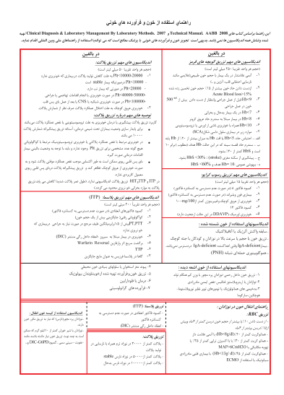
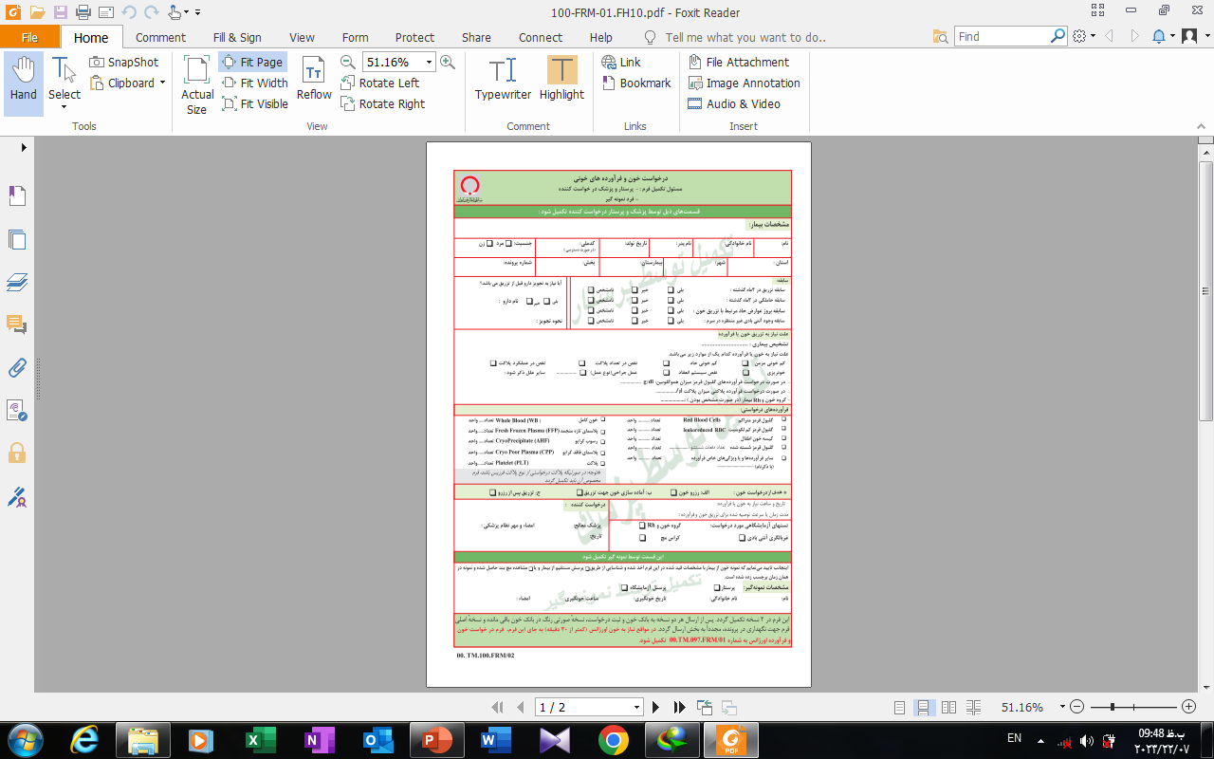

Slide 13
order
• Type and screen
• Crossmatch red blood cells
• Special requests
- irradiation, CMV-negative, antigen-matched, etc.
Oral orders may be accepted
  if followed by the written request

Slide 15
Pretransfusion Testing
The most critical step is proper collection and identification of the recipient blood sample
The most common cause of an acute hemolytic transfusion reaction is misidentification of the sample or patient
policies and procedures

Slide 16
pretransfusion samples
should be labeled
  at the time of phlebotomy
  by comparison with the patient’s permanent identifier
  at least two unique identifiers
  The date of sample collection
  the identity of the phlebotomist
when the patient is unknown, a unique identifier must be assigned, throughout the course of transfusion

Slide 17
phlebotomy
Transfusion request and labeled patient blood sample must contain at least two pieces of independent identifying
  information for patient (name, hospital number, date of birth)
Mechanism to identify the date of sample and the phlebotomist (paper or electronic)
Transfusion service will ensure that identifying information on the requisition and sample label are in agreement

Slide 18
accurate identification of the component and the intended recipient is essential
two unique recipient identifiers
comparison with a permanent identifier
unit identifier on the blood container

Slide 19
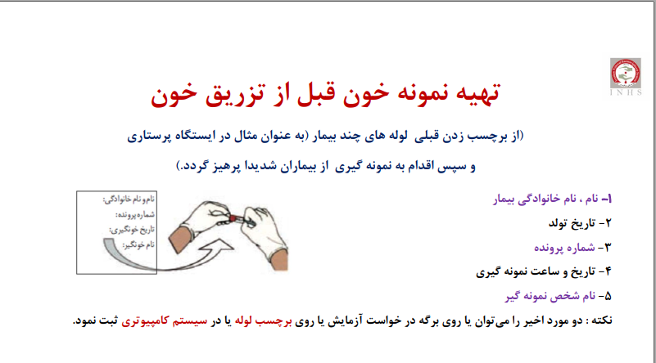

Slide 20
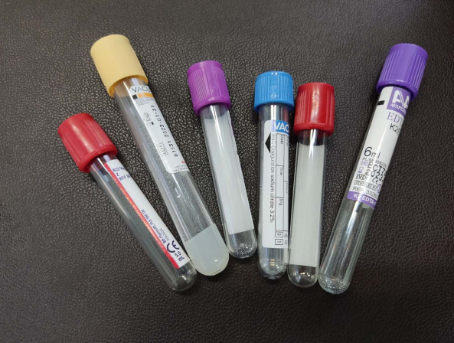

Slide 21
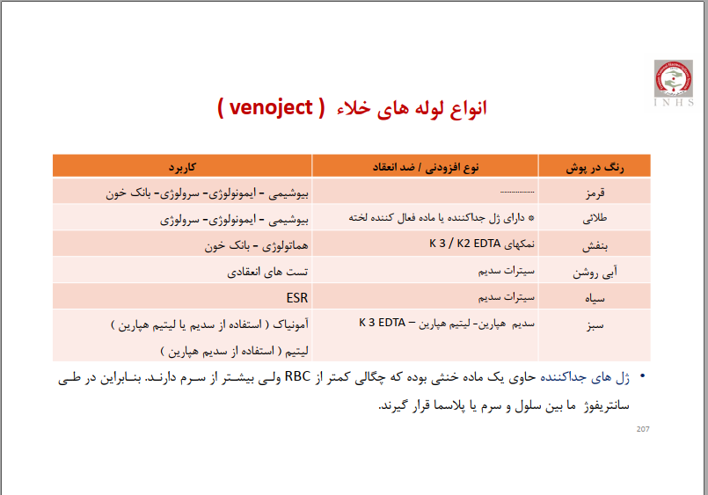

Slide 22
Type of Sample
serum has traditionally been the preferred specimen
  collected in siliconized plain tubes without serum separator gel
plasma is increasingly used owing to newer testing technologies
a specific type of sample per manufacturer instructions
  gel column agglutination, microtiter plates, and automated testing systems

Slide 23
Technical Problems with plasma in AHG
small fibrin clots can trap RBCs and resemble agglutination
Fibrin may trap serum and cause neutralization of AHG reagent
High fibrinogen levels can enhance rouleaux formation

Slide 24
Appearance
Most laboratories reject grossly hemolyzed samples
  unless there is no other choice
  mask antibody-induced hemolysis, detectable in screening test
Lipemia rarely cause difficulty
  not usually a cause for rejection
additional specifications in Automated instruments
  grossly hemolyzed or lipemic sample can give false-positive readings with an automated gel technology instrument

Slide 25
Age of Sample
According to AABB Standards
In elective surgery patients, some facilities will extend up to 1 month
A negative antibody screen
no history of clinically significant antibodies
is not pregnant
not been transfused within the preceding 3 months

Slide 26
Samples for pretransfusion
should be collected no more than 3 d
  unless the patient is not pregnant and not transfused within the preceding 3 m
should be collected no more than 1 d, if the patient is transfused within the preceding 10 d
admission on the same day as elective surgery
  may be collected during a preceding outpatient visit
must be retained until 7 d after each transfusion

Slide 27
Sample Storage
According to AABB Standards
be stored at 1-6° C for at least 7 days
  all pretransfusion samples
  at least one segment from each of the donor units
to ensure that repeat or additional testing may be performed later
if the patient experiences a delayed hemolytic reaction or other adverse effect of transfusion

Slide 28
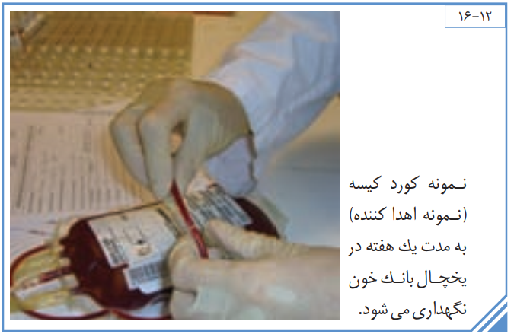

Slide 29
Routine pretransfusion tests
ABO and Rh (D) typing
screening for unexpected red cell antibodies

Slide 30
Recipient testing
• Clinically significant antibodies
  Method must include 37° C incubation with conversion to antihuman globulin using reagent red cells that are not pooled
• Significant adverse events to transfusion
• Special transfusion requirements
• Previous ABO group and Rh type
• Difficulty in blood typing

Slide 31
ABO Grouping
Antisera and reagent RBCs for ABO grouping are standardized and readily available commercially
Mostly use monoclonal reagent antisera derived from antibodies produced by hybridoma cell lines
ABO grouping: forward type and back type
  an 3-5% RBC suspension tested with commercial anti-A and anti-B
  patient or donor serum is tested against reagent cells of known A1 and B
At room temperature
only an immediate-spin centrifugation step

Slide 32
ABO Grouping of Recipients
Every pretransfusion patient blood specimen must also be tested for ABO group
Both cell and serum groupings are required for initial ABO testing of all patient sample
results should agree with each other

Slide 33
Interpretation is generally straightforward
Any discrepancy in current testing or disagreement with previous records must be resolved
before pretransfusion testing can be concluded.

Slide 34
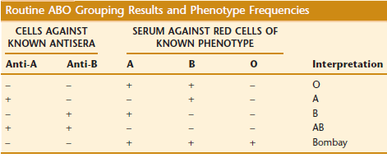

Slide 35
ABO Grouping Discrepancies
If do not agree, testing is repeated to rule out any clerical or technical error
If results still disagree, an ABO discrepancy is present
owing to problems with the patient’s serum or cells
must be resolved before an ABO type can be confirmed

Slide 36
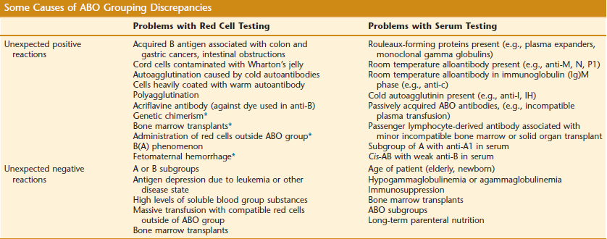

Slide 37
in immunosuppressive disease or therapy
  may lack expected isohemagglutinins
Newborns
  weak or absent isohemagglutinins, may not be present until 6 m of age
  weakly expressed Rh(D) antigen

Slide 38
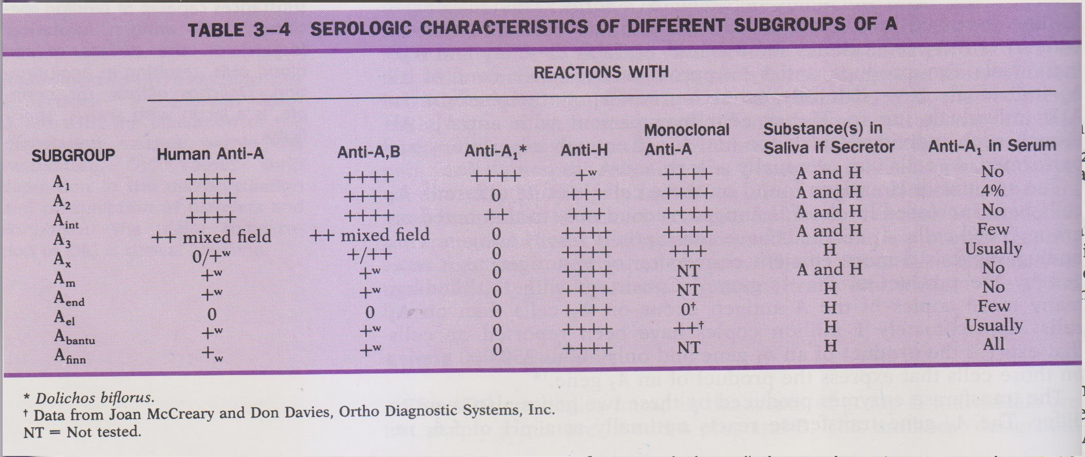

Slide 39
Recently transfused patients
may show a mixture of circulating red cells
  if they have not received ABO-identical units
transfusion of platelet concentrates or immunoglobulins
  Unexpected red cell antibodies can be acquired passively

Slide 40
blood type cannot be concluded
In urgent situations
group O red cells and group AB plasma is usually safe

Slide 41
Blood bank arrangements:
The degree of urgency for transfusion should be accurately conveyed to the blood bank:
1. Routine technique
2. the blood is required urgently
3. very urgent cases
4. extreme urgent situation

Slide 42
1. Routine techniques
ABO and Rh(D) grouping
antibody screening
cross-matching by saline and Coombs' technique
take about 3 hours

Slide 43
2. the blood is required urgently
ABO and Rh (D) typing
cross-matching by saline spin technique or LISS method
the time of requirement should be mentioned on the requisition form

Slide 44
documentation of the medical order for emergency release of blood components
should be obtained

Slide 45
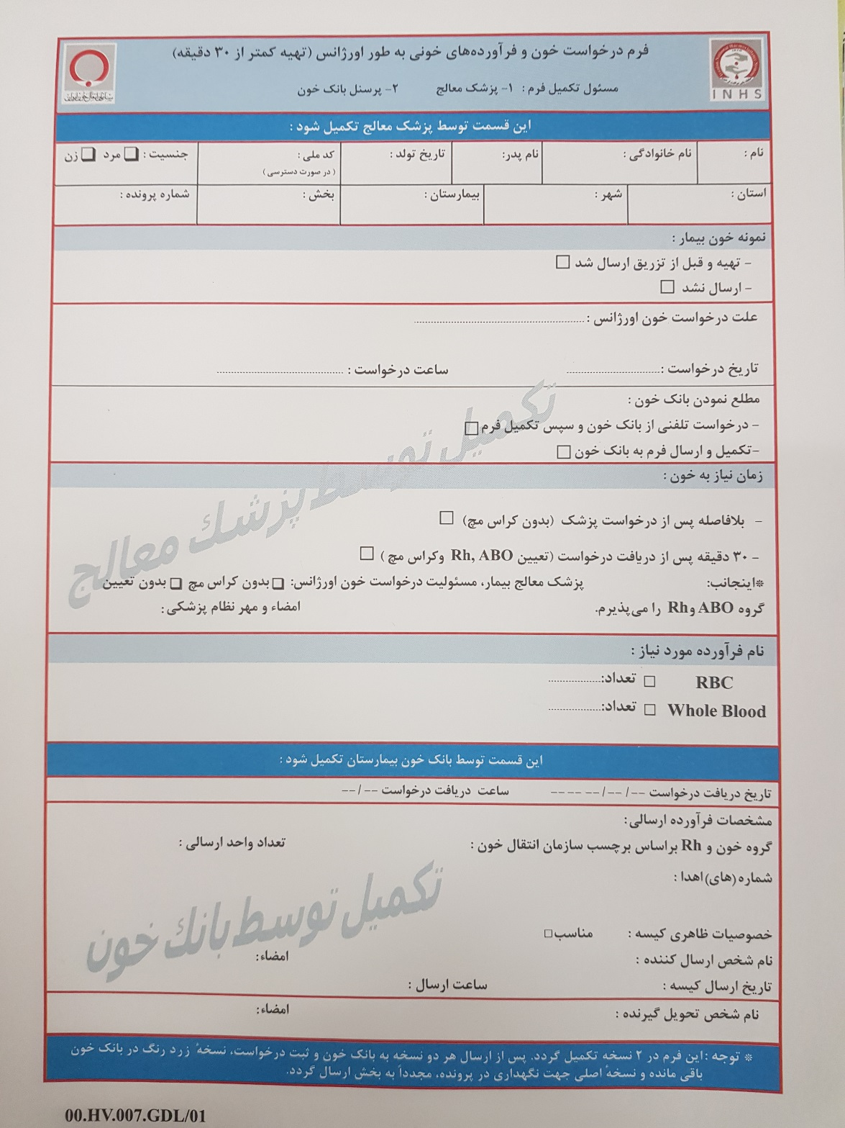

Slide 47
3. very urgent cases
ABO and Rh (D) typing
uncross-matched red cells of the same group
Subsequently the cross-matching is done by saline spin tube method or by LISS technique
with the concurrence of clinicians

Slide 48
emergency release of blood components
ABO compatibility is the first priority
Antibodies to other blood group antigens
  are of lower priority
  typically do not cause acute hemolytic reactions

Slide 49


Slide 50
4. extreme urgent situation
uncross-matched group O red cells
if the group of the patient is not known
there is no time to do ABO and Rh(D) grouping

Slide 51
Rh-compatibility
It is highly desirable to transfuse only Rh-negative red cells to Rh-negative recipients
  a 30% risk for immunization to Rh(D)
  particularly important for women of childbearing potential
  risk for hemolytic disease of the newborn in subsequent pregnancies

Slide 52
4. extreme urgent situation
there is no time to do ABO and Rh(D) grouping
pre-menopausal females, O Rh(D) negative red cells should be given to avoid Rh(D) sensitization and the risk of HDFN
O Rh(D) positive red cells can be given to Rh(D) negative males and post-menopausal females patients if they do not have Rh antibodies in their blood and Rh (D) negative blood is not available

Slide 53


Slide 54
Rh Typing of Recipients
by direct typing
  Indirect testing for weak D in recipients is not necessary.
  Patients who fail to agglutinate are Rh-negative
Some blood banks perform weak D testing for prenatal specimens
  many weak D individuals possess a partial D phenotype and are at risk for RhD alloimmunization

Slide 55
Donor testing
• Confirmation testing for ABO group
required on all units
serum testing not required
• Confirmation of Rh type
required only on Rh-negative
weak D testing is not required

Slide 56


Slide 57
Rh Typing of Donors
the collecting facility:
by direct agglutination methods
All Rh-negative donors are tested for a weak D phenotype
If weak D testing is positive, the unit is labeled Rh-positive
The transfusion service:
reconfirm the D type of all RBC units labeled Rh-negative
Repeat testing of weak D is not required

Slide 58
Direct typing for the D antigen
at room temperature
By the immediate spin
mixing one drop of 3-5% RBCs and one drop of anti-D
weak D testing: RBCs are tested by IAT with an IgG anti-D
A parallel test with a negative diluent control is always included for the weak D test

Slide 59
Important events in compatibility testing

Slide 61
an antigram for a two-cell screen

Slide 63
Single alloantibody
Probably lgG antibody

Slide 64
Unexpected red cell antibodies
If the antibody screen is positive, antibody identification tests should be performed
For clinically significant antibodies, antigen-negative cells are selected for cross-match
the cross-match should be performed by antiglobulin technique

Slide 65
anamnestic response
Results of current testing should be compared with records of the previous Testing
Clinically significant antibodies may become undetectable over time but may cause delayed hemolytic reactions

Slide 66
a history of prior antibodies
Previous difficulties in blood typing
significant adverse events to transfusions
special requirements for blood products should also be reviewed
selection of antigen negative component
cross-match by antiglobulin technique

Slide 68
the antibody is clinically significant
Antigen negative blood should be crossmatched regardless of the strength of the antibody
The units may be typed:
anti-D, -C, -c, -e, -f,
anti-Fyª, -Fy^{b}, anti-Jkª, -Jk^{b},
anti-K, anti-S and -s

Slide 69
the antibody is not clinically significant
Crossmatched compatible units at the antiglobulin phase
  If the quantity of serum is limited, the units may be typed:
  anti-A₁, -Leª, -Le^{b}, Luª, -M, -N and -P₁

Slide 70
the antibody reacts at the antiglobulin phase but is not clinically significant
Crossmatched compatible units
the least incompatible unit, if cannot be found
HTLA antibodies (Ch, Rg, JMH, Csª, Ykª and McCª), Bg (leukocyte-related), anti-Sdª
If the quantity of serum is limited, the units may be typed for selecting units: anti-A₁, -Leª, -Le^{b}, Luª, -M, -N and -P₁

Slide 71
the antibody to a low frequency antigen
Reagent antiserum is not available
  By anti-C^{w}, -Jsª, Kpª and -Wrª
Selection is not difficult

Slide 72
If antibody identification tests cannot be completed
a medical judgment must be made regarding the urgency of transfusion and the risk for incompatibility
It may be desirable to issue red cells lacking antigen specificities that cannot be excluded, if available.

Slide 73
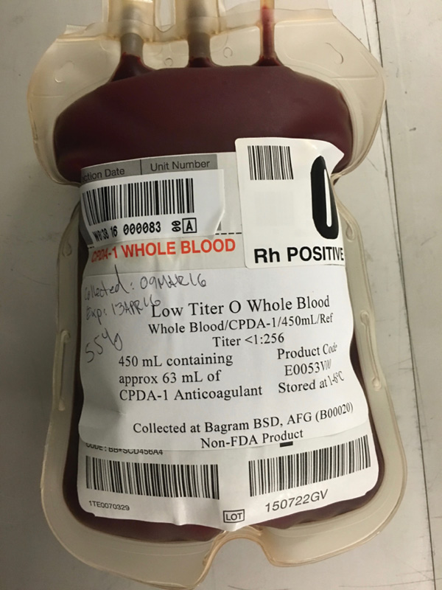

Slide 74
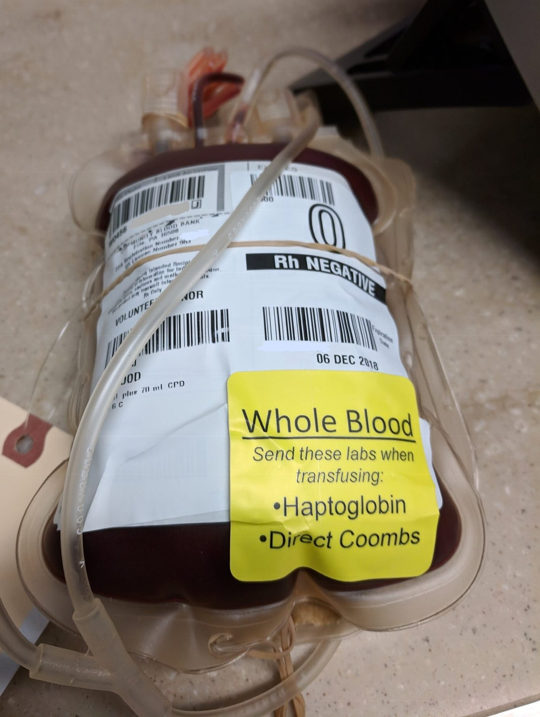
Whole Blood

Slide 75
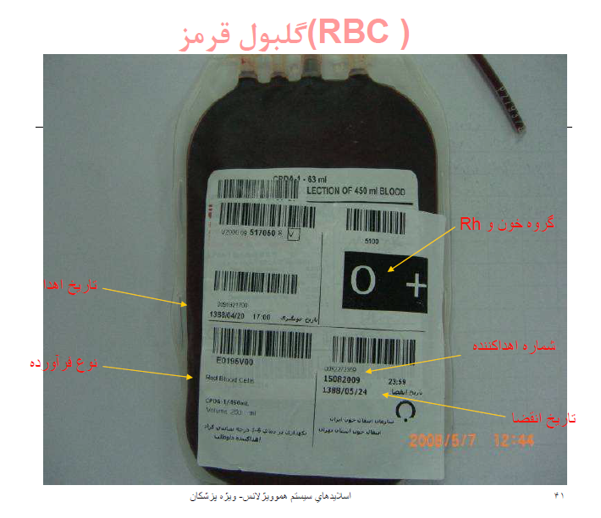
Packed Red Cells

Slide 76
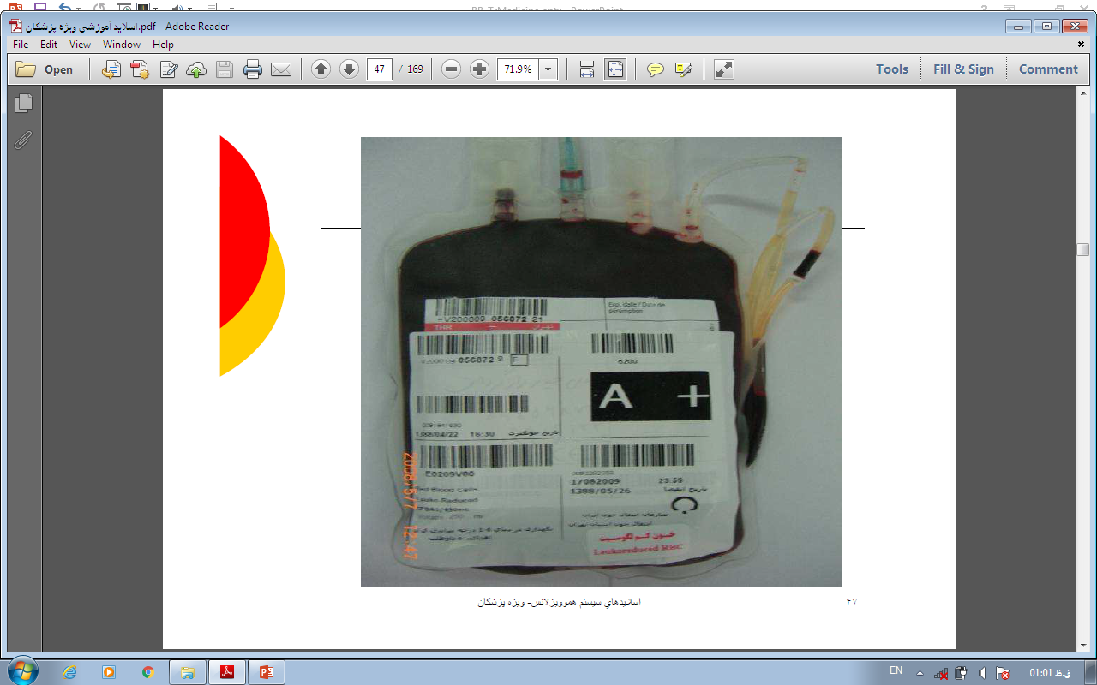
leukocyte-reduced RBC

Slide 77
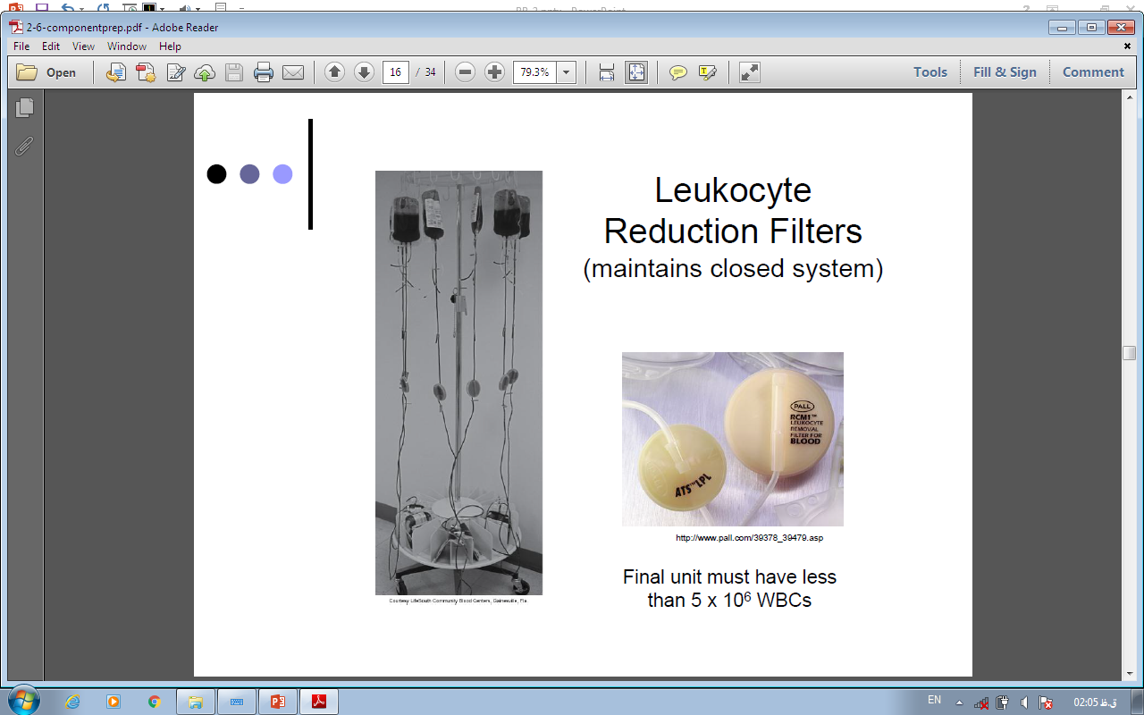

Slide 78
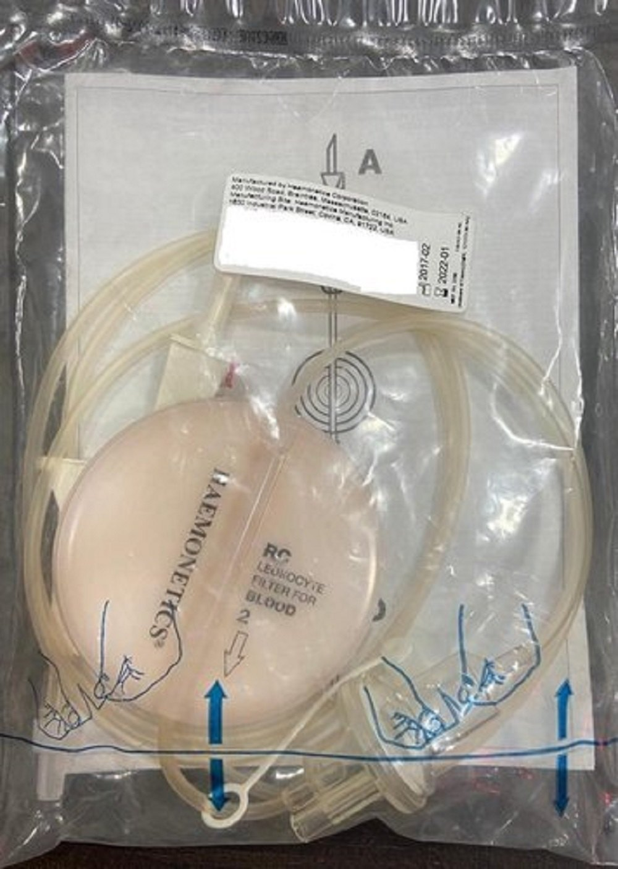
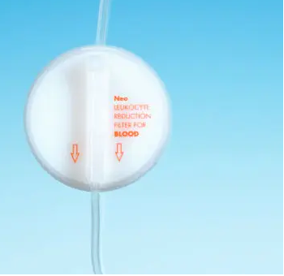
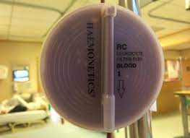

Slide 79
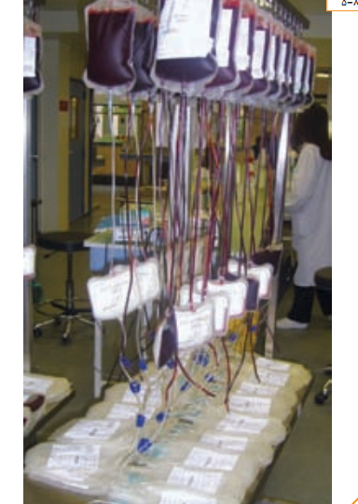

Slide 80
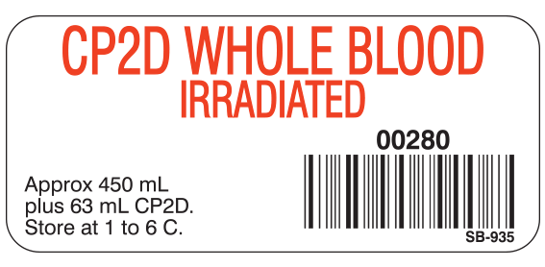
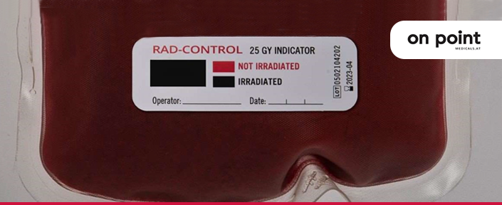
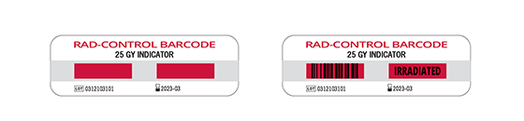

Slide 81
Frozen red cells
Washed red cells
CMV seronegative red cells

Slide 82
Neonatal And Pediatric Transfusion

Slide 83
aliquots of a single unit
can significantly reduce donor exposures
For a premature infant with an expected ongoing transfusion requirement
until outdate

Slide 84
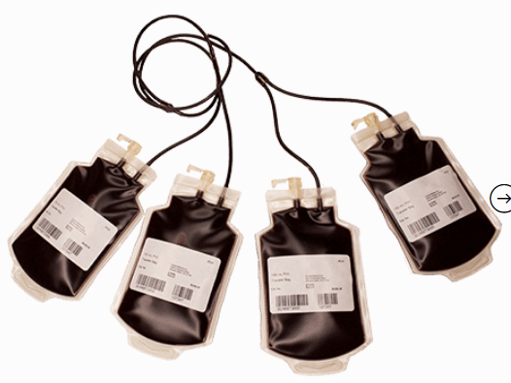
Multiple-bag Aliquot System

Slide 85
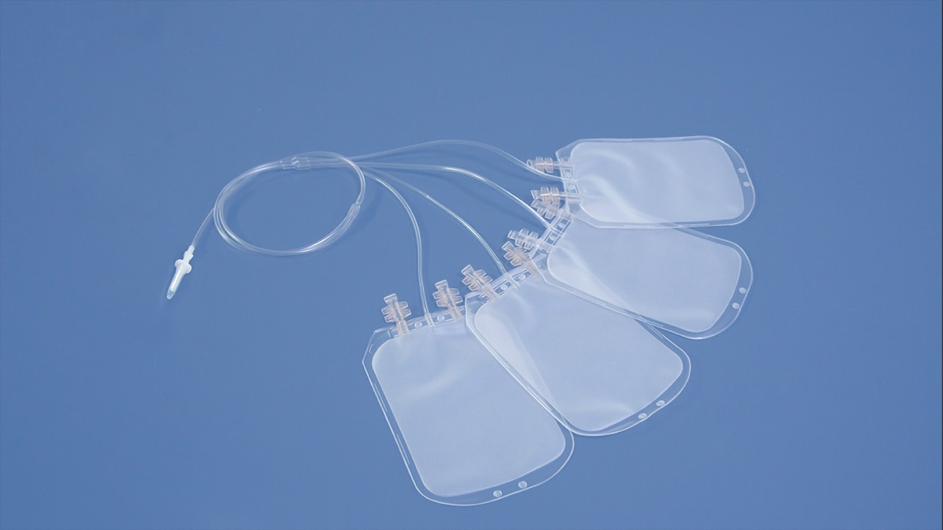

Slide 86
Exchange transfusion of the neonate for hyperbilirubinemia
Whole blood
RBCs reconstituted with compatible plasma to Hct of 45% can be used

Slide 87
تزريق خون كامل
همگروه از نظر سيستمABO&Rh
با گيرنده الزامي است

Slide 88
گلبول قرمز متراکم ((Packed Red Cells
تزريق همگروه يا
سازگار از نظر سيستم ABO با پلاسماي گيرنده

Slide 89
ABO compatibility
whole blood must be of identical ABO type to the recipient
Red blood cells, plasma and platelet concentrates need to be compatible but not necessarily identical

Slide 90
Transfused red cells must be compatible with recipient antibodies
Transfused plasma must be compatible with recipient red cells

Slide 91
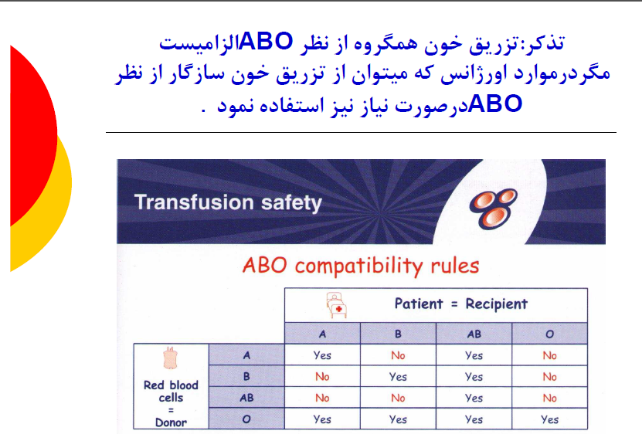

Slide 92
Crossmatch
The final step of pretransfusion compatibility testing
final check of ABO compatibility
detection of unidentified antibodies

Slide 93
Crossmatch
Full antiglobulin crossmatch required
  current antibody screen is positive
  a known history of clinically significant antibodies

Slide 94
Two components of Crossmatch
Major cross-match
  between the recipient’s serum or plasma and donor red cells
Minor cross-match
  between recipient red cells and donor or plasma, usually unnecessary

Slide 95
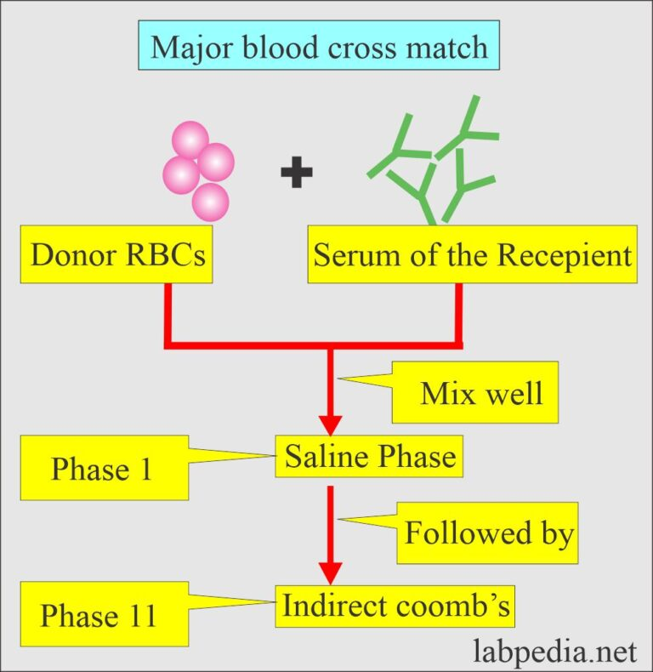

Slide 96
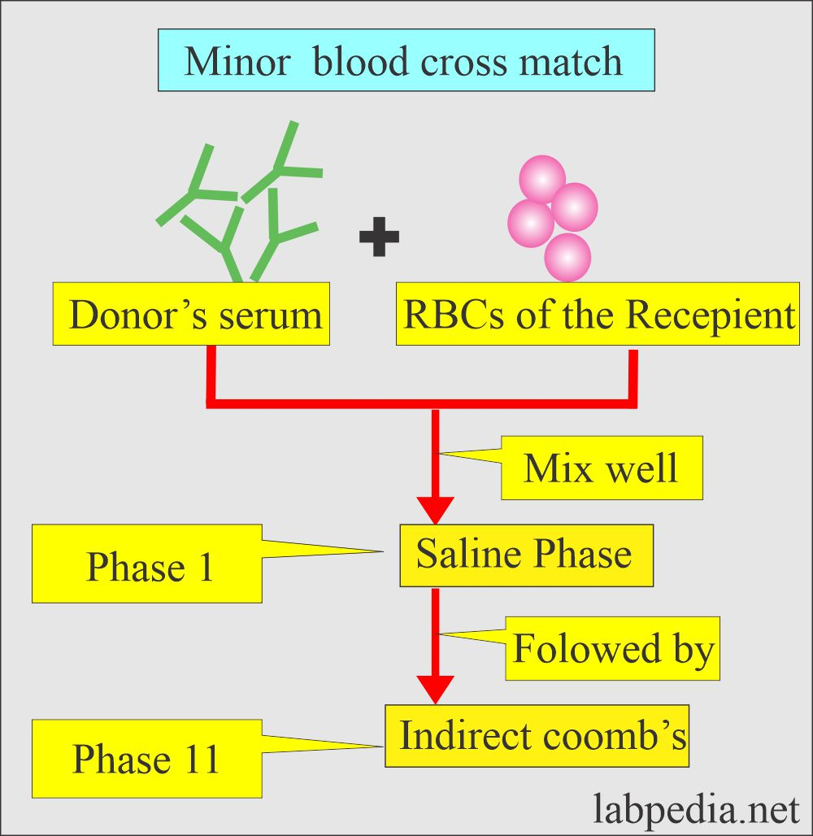

Slide 97
direct agglutination
(immediate spin)
In the absence of unexpected red cell antibodies, can be performed
A drop of donor cell suspension is mixed with recipient serum
  centrifuged immediately
  Examined for hemolysis and/or agglutination

Slide 98
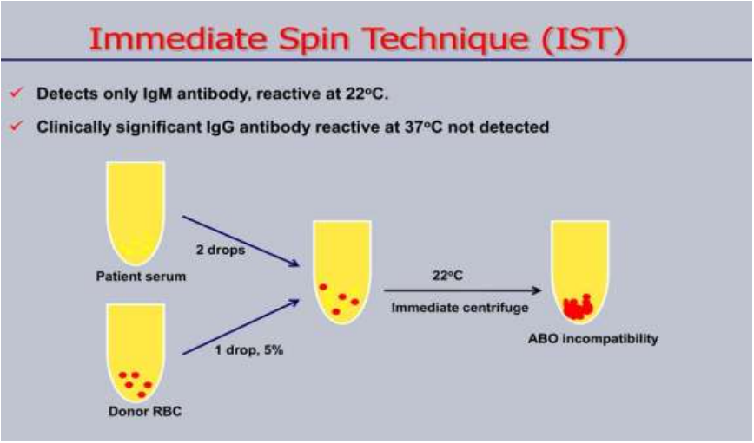

Slide 99
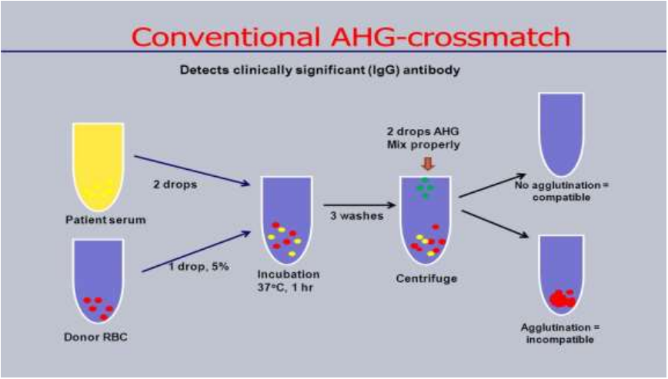

Slide 100
so-called computer crossmatch
An alternative for ensurance of ABO compatibility, 1990s
at least two determinations of the recipient’s ABO group
  at least one on a current sample
Computer system

Slide 101
Requirements for Implementation of the
Electronic Crossmatch

Slide 102
Preoperative Crossmatch Protocols
a type and screen–only protocol for elective surgical procedures that do not routinely require transfusion
Blood orders for elective surgical procedures requiring transfusion are set at a level that reflects actual usage patterns for a given operative procedure
Notes:
جدول حداکثر درخواست خون در جراحی ها

Slide 103
periodic review & revision
preoperative blood ordering guidelines
maximum surgical blood order schedule

Slide 104
Goals of
Preoperative Protocols
much more efficient blood inventory management
  reduction in the crossmatch/transfusion (C/T) ratio
  a minimal turnaround time

Slide 105
Some blood bank laboratories still choose to perform a full antiglobulin crossmatch for all transfusions,
regardless of history and
pretransfusion testing results

Slide 106
Platelet Concentrates
(PC ) (Random Donor Platelets)
(Single Donor Platelets)

Slide 107
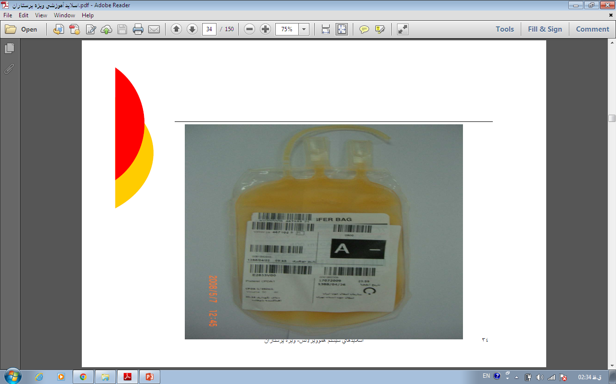

Slide 108
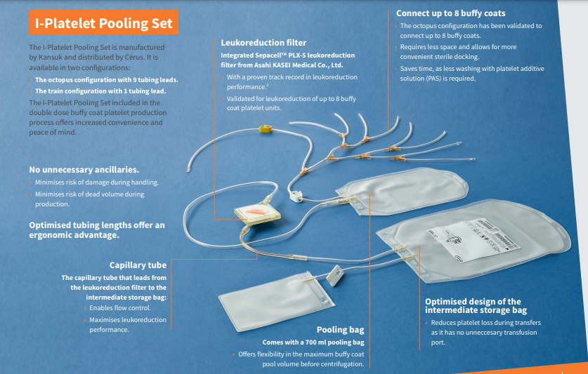

Slide 109
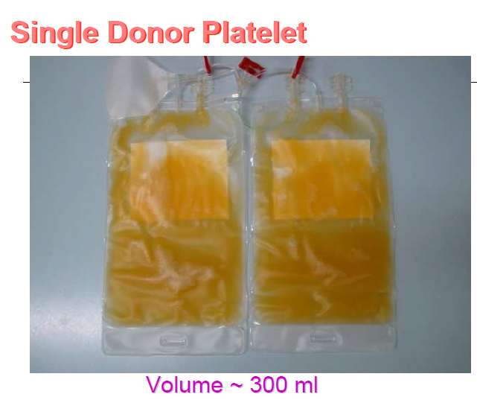

Slide 110
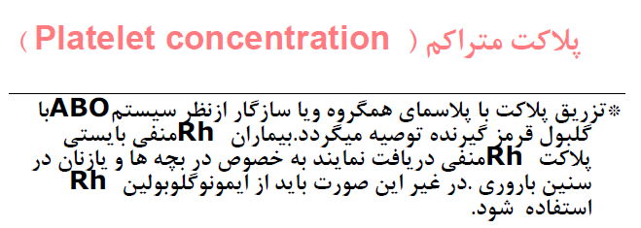

Slide 111
Rh antigens
are not present on platelets; contaminating RBCs with Rh antigens
  (RD-PC have <0.5ml RBC)
  (SD-PC have <2ml)
visibly apparent red cells can cause alloimmunization
Consider Rh prophylaxis with Rh incompatibility in females

Slide 112
ABO compatibility
plasma compatibility in non–ABO-identical
ABO antigens are expressed weakly on platelets
ABO incompatible platelets may result in lower posttransfusion survival, usually not significant

Slide 113
ABO compatibility
Transfusion of high-titer isohemagglutinins (>1:200) in apheresis platelets can cause an acute hemolytic reaction
  high-titer incompatible aphresis platelets are not transfused

Slide 114
ABO compatibility
neonates, small blood volume, ABO incompatible plasma should be minimized
– ABO compatible platelets only
– or reduce the plasma

Slide 115
Fresh Frozen Plasma
پلاسمای تازه منجمد

Slide 116
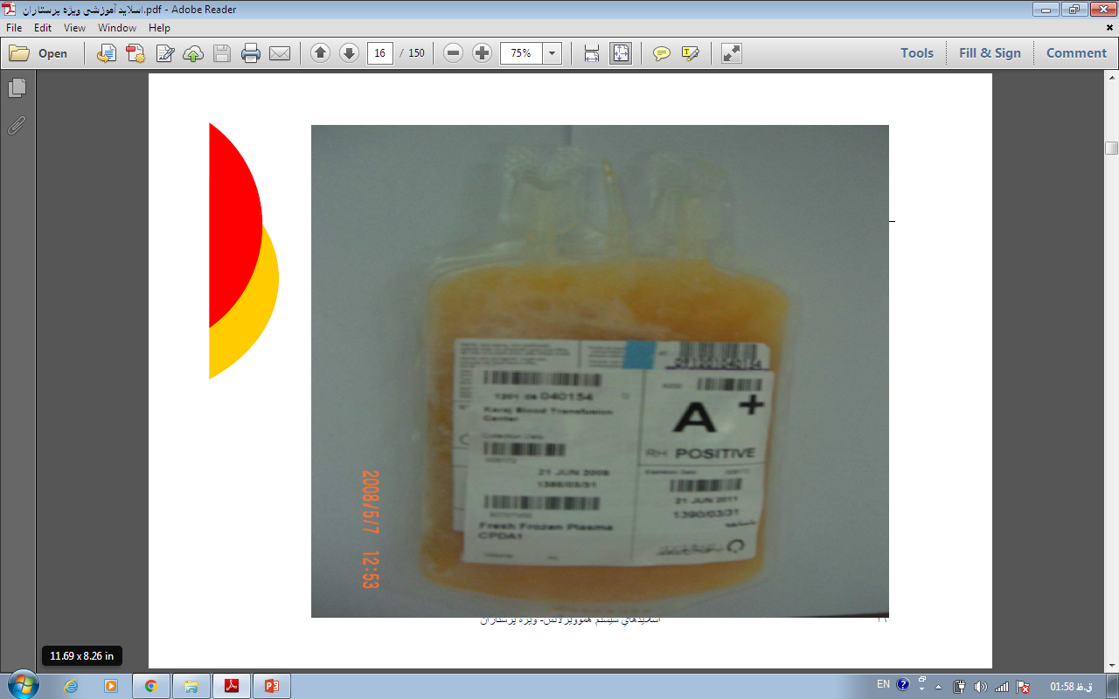

Slide 117
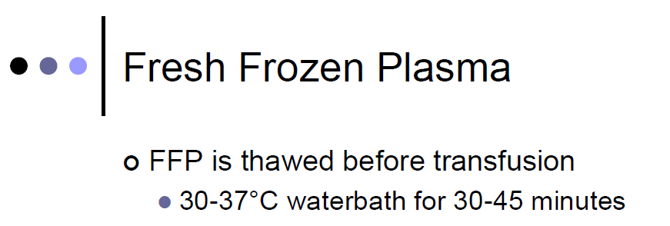
باید از طریق فیلتر استاندارد 260-170 میکرونی تزریق شود.

Slide 118
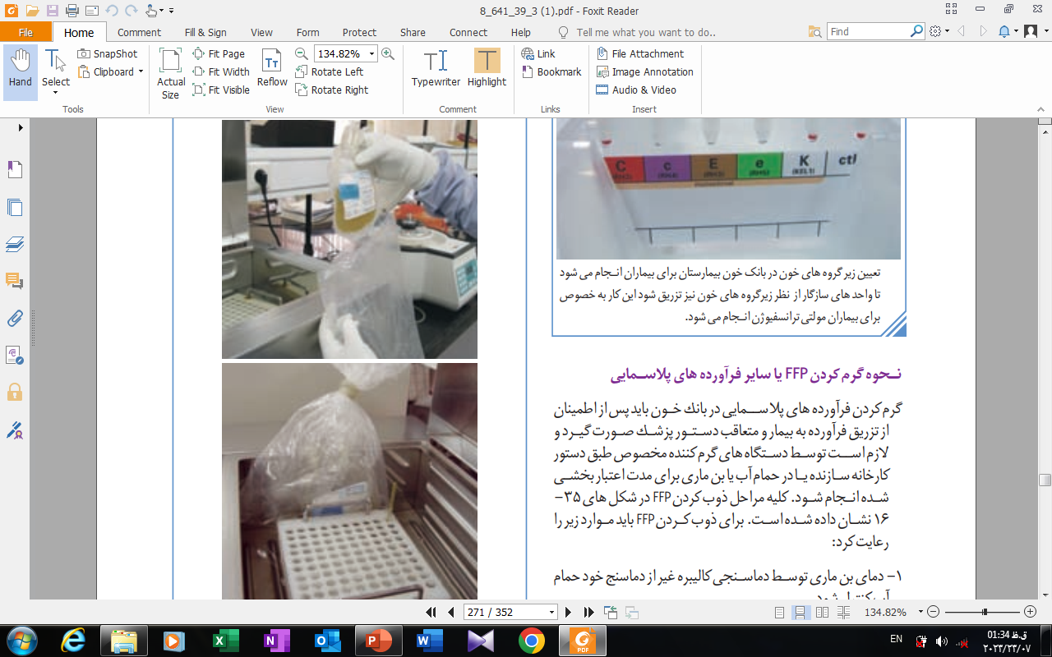

Slide 119
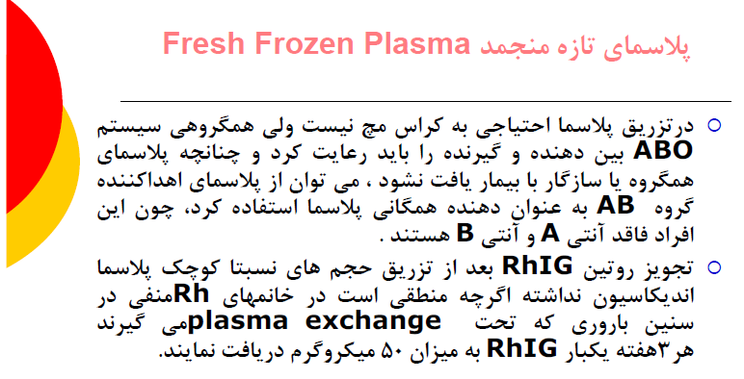

Slide 120
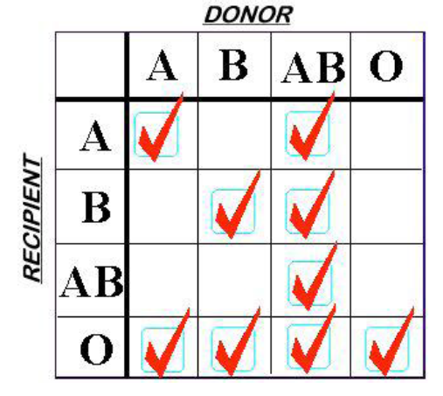
Plasma has ABO antibodies, so must be ABO compatible with recipient.
Rh compatibility: Not an issue.

Slide 121
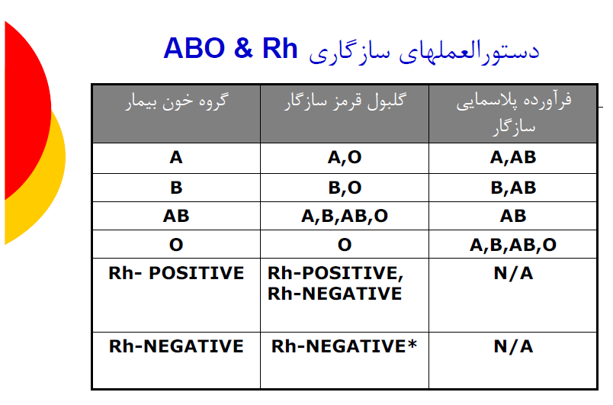

Slide 122
Cryo precipitate
کرایوپرسیپیتات

Slide 123
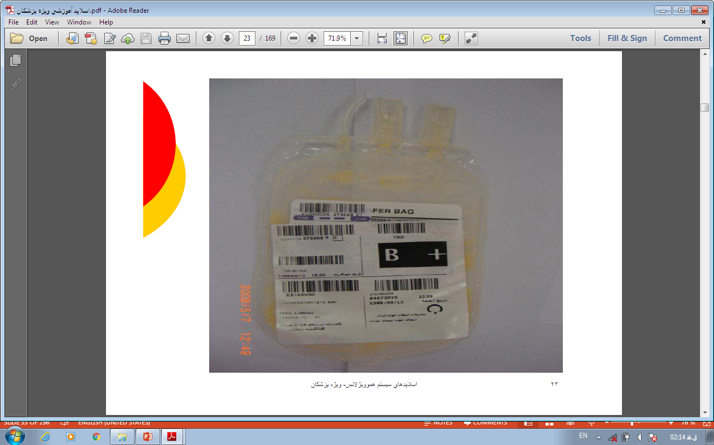
Cryoprecipitated Antihemophilic Factor

Slide 124
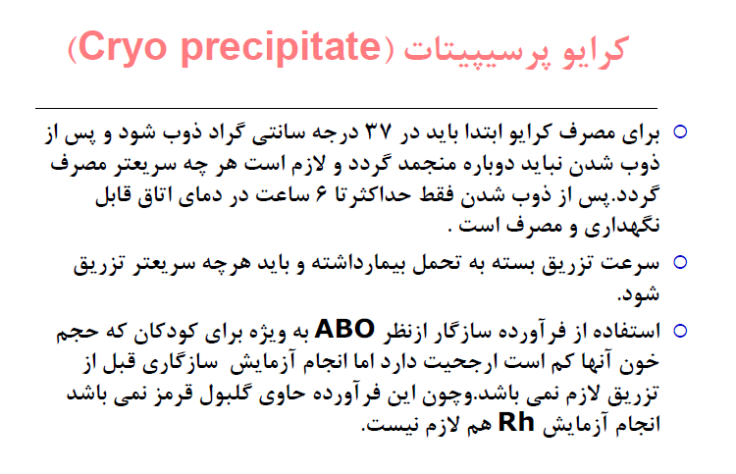

Slide 125


