Slide 2
Appropriate measurement of BP is extremely important when diagnosing hypertension .Recent hypertension guidelines recommend lower BP thresholds for the diagnosis of hypertension, necessitating accurate assessment of BP to avoid misdiagnosis, overtreatment, and undertreatment.

Slide 3
With the obsolescence of mercury sphygmomanometers, BP measurements can be performed using manual aneroid manometers with auscultation of Korotkoff sounds or using automated (i.e., oscillometric) BP monitors

Slide 4
Measurement Technique:
Ensuring the accuracy of BPs is critical to the appropriate diagnosis of hypertension in and out of the office .Appropriate BP measurement technique for in-office measurements and when educating patients on performing self-monitoring of BP (SMBP) is often overlooked, owing to space and time constraints in routine practice

Slide 5
Both in-office and SMBP should occur after the patient rests for 3 to 5 minutes, in a quiet room, in the seated position, with feet flat on the floor, back sup-ported, arm supported and at the level of the heart, correct cuff size, against a bare arm, with an empty bladder, and with no caffeine or cigarette smoking 30 minutes before the measurement.

Slide 6
Of note, an examination table often does not provide sufficient leg, back, and arm support to facilitate accurate BP measurement. For educating patients on SMBP, infographics reviewing the necessary steps for accurate BP measurement can be extremely helpful and are freely available.

Slide 7
Device Selection and Accuracy of Different Devices

Slide 8
Owing to the wide elimination of mercury devices over concerns of toxicity risk, aneroid manometers are now used to perform most manual BP measurements in the clinic. Aneroid manometers are prone to miscalibration over time and require reassessment every 6to 12 months by qualified clinical engineering staff (which is not always available) to ensure accuracy.

Slide 9
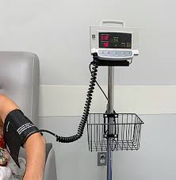
In-Office Blood Pressure Measurement
In most patients, BP is routinely assessed in the clinic setting using a manual aneroid sphygmomanometer or an automated blood pressure monitor., there can be a substantial fall in the systolic and diastolic BP with each subsequent clinic visit .Thus, patients with mild to moderate elevations in BP should not be diagnosed with hypertension based on an initial office reading.

Slide 10
According to the previous 2018 European and current international guidelines ,hypertension is defined based on
repeated office SBP values ,140 mmHg and/or DBP 90 mmHg. However, there is a continuous relationship between BP and CV or renal morbid or fatal events starting from an office SBP >115 mmHg and a DBP >75 mmHg .Therefore, this definition is arbitrary and has mainly the pragmatic purpose of simplifying the diagnosis and decision on hypertension Management.

Slide 11
Automated office BP measurement (AOBP) uses a fully auto-mated oscillometric BP monitor to measure multiple consecutive BP readings with a single activation. AOBP may overcome the white coat effect (i.e., isolated office hypertension) because it is more closely correlated to research-quality BPs and daytime ambulatory BP readings than routine in-office BP measurements.

Slide 12
Out-of-Office Blood Pressure Measurement
Out-of-office BP is more closely linked to long-term cardiovascular and renal outcomes than in-office BP monitoring. Out-of-office BP measurement can be performed using 24-hour or 48-hour ABPM and SMBP at home.

Slide 13
Ambulatory Blood Pressure Monitoring
ABPM is currently recommended by the ACC/AHA for the initial diagnosis of hypertension in most patients with a clinic bloodpressure≥120/70 mmHg. Owing to its distinctively strong association with adverse cardiovascular outcomes, ABPM is considered to be the reference standard for BP measurement

Slide 14
ABPM measures BPs over a 24-hour to 48-hour period using a fully automated device. The BP measurements are programmed to occur at fixed intervals, often every 15 to 30 minutes during the daytime and every 30 to 60 minutes during the nighttime. Thus, ABPM captures BPs during routine daily activities and during sleep.

Slide 15
Elevated 24-hour ABPM is strongly associated with cardio-vascular events and mortality. For example, in an international cohort study of 11,135 adults who underwent 24-hour ABPM, every 20mmHg increase in 24-hour systolic BP was associated with a 40%increased risk of major cardiovascular events (hazard ratio [HR],1.40; 95% CI, 1.31 to 1.50) after adjustment for clinic BP.

Slide 16
Among individuals with chronic kidney disease (CKD), elevated24-hour ABPM is associated with poorer kidney function, higher degree of proteinuria, and greater prevalence of left ventricular hypertrophy (LVH) at the time of ABPM assessment.

Slide 17
Self-Monitoring of Blood Pressure at Home
SMBP typically occurs using a semi automated device that patients activate themselves to measure their BPs at home. SMBP engages patients directly in the diagnosis and management of their own hypertension, and can provide the opportunity for improved BP control among those patients who already have a diagnosis of hypertension .For the diagnosis of hypertension, SMBP should ideally be measured twice in the morning and twice in the evening before going to sleep for 5 to 7 consecutive day.

Slide 20
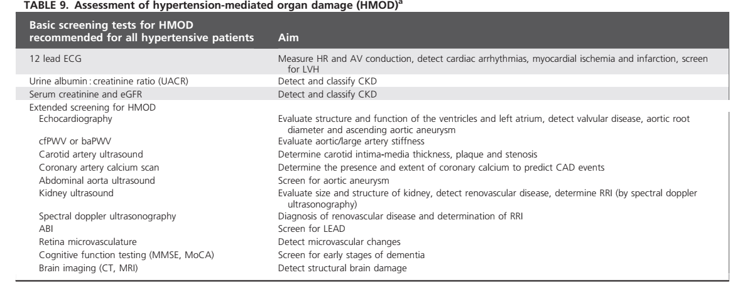

Slide 21
Assessment of hypertension-mediated organ damage
HMOD refers to structural or functional changes in large and small arteries or end-organs (brain, heart, kidney and eyes), caused by elevated BP and is a marker of preclinical or asymptomatic CV or kidney disease .HMOD is common in severe or long-standing hypertension but can also be found in less severe hypertension. With wider use of imaging, HMOD is becoming increasingly detected in asymptomatic patient

Slide 22
In the name of GOD
Hypertension Management Before Surgery In CKD
Farahnoosh Farnood
Department of Internal Medicine, School of Medicine, Kidney Research Center, Tabriz University of Medical Sciences, Tabriz, Iran

Slide 23
Preoperative evaluation and preparation of CRF patients is mandatory to minimize perioperative morbidity and mortality
There are significant disparities in the prevalence of HTN among CKD patients, HTN was present in 80% of whites and 93% of African Americans with a GFR less than 60 mL/min/1.73 m2
Preexisting hypertension is the most common medical reason for postponing surgery.

Slide 24
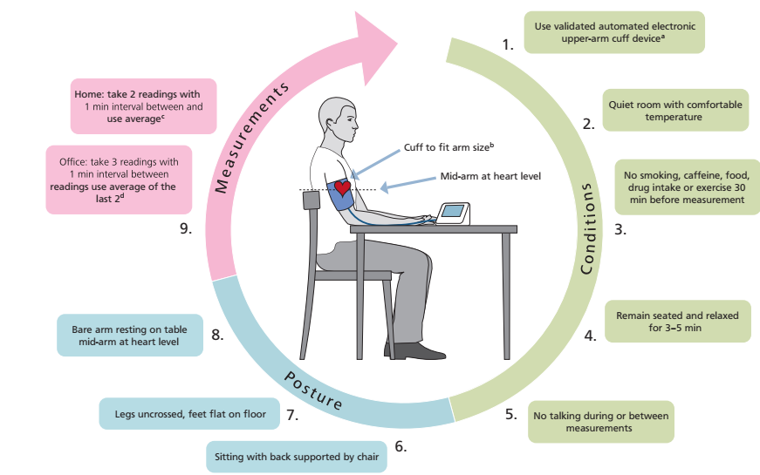

Slide 25
• sympathetic stimulation during laryngoscopy and endotracheal intubation
• surgical stimulation (Inadequate anesthetic depth during painful surgical
stimulation)
• emergence and tracheal extubation
• hypercarbia or hypoxemia (due to sympathetic stimulation) -higher fraction of inspired oxygen (FiO2)
• Hypervolemia
• withdrawal of antihypertensive medications • bladder distention

Slide 26
In patients more than 65 yr of age undergoing non-cardiac surgery, there is evidence that low preoperative arterial pressure is more strongly associated with increased postoperative risk of mortality than high pressure using primary care data.
mean arterial pressures below 65 mmHg sustained for more than 15 minutes are associated with myocardial and renal injury.

Slide 27
In a large study, increased mortality risk was identified in patients with a preoperative systolic arterial pressure <119 mm Hg, diastolic <63 mm Hg
the J curve phenomenon for the association between
preoperative systolic, diastolic, and pulse pressures, and
postoperative mortality

Slide 29
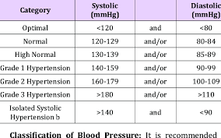
not to avoid or postpone surgery in untreated patients with grade 1 hypertension. In untreated patients with grade 2 or 3 hypertension or in badly uncontrolled treated patients, surgery should be deferred until BP control is reached.
Except for emergency surgical interventions, this should be the rule when SBP is >180 mmHg or DBP >110 mmHg

Slide 30
CKD patients often have higher BP and their auto regulations are also set at higher levels. it will be prudent to reduce the blood pressure by 20% during the intraoperative period, and then slowly targeting towards the goal in the postoperative period over the next few days.

Slide 31
1-High systemic arterial blood pressure in isolation is not a reason to cancel elective surgery per se.
2-Preoperative decisions should be made on each patient's overall cardiac risk rather than solely on the blood pressure reading.
3-Combination tablets could complicate preoperative
management of antihypertensive pharmacotherapy.

Slide 32
management

Slide 33
Beta blockers
Beta blockers have a number of potential beneficial effects when taken perioperatively. Beta blockers reduce ischemia by decreasing myocardial oxygen demand due to increased catecholamine release. They may also help prevent or control arrhythmias.
Acute withdrawal of a beta blocker pre- or postoperatively can lead to substantial morbidity and even mortality .

Slide 34
In light of the potential benefits of perioperative beta blockade, minimal adverse effects, and consequences of acute withdrawal, we recommend that beta blockers be continued in the perioperative period and continued throughout the hospital stay.
The dose of the beta blocker should be closely regulated throughout the perioperative period to maintain the blood pressure and heart rate.

Slide 35
Alpha 2 agonists
Although earlier smaller randomized trials suggested that centrally acting sympatholytic drugs such as clonidine may improve perioperative outcomes ,the larger randomized trial found that preoperative initiation of low-dose clonidine resulted in increased harm (no change in mortality or myocardial infarction but increase in clinically significant hypotension and nonfatal cardiac arrest)
For patients already taking clonidine, abrupt withdrawal of clonidine can precipitate rebound hypertension.

Slide 36
Given the possible negative consequences of withdrawal, we recommend that alpha 2 agonist drugs be continued in the perioperative period, but not initiated.

Slide 37
Calcium channel blockers
Despite little data regarding calcium channel blockers during the perioperative period, these agents appear safe and have theoretic benefit .data regarding bleeding risk are contradictory. Thus, we recommend that calcium channel blockers be continued in patients who are already taking them preoperatively.

Slide 38
ACE inhibitors and angiotensin II receptor blockers
The management of patients taking angiotensin-converting enzyme (ACE) inhibitors and angiotensin II receptor blockers (ARBs) preoperatively is controversial.
ACE inhibitors and ARBs can theoretically blunt the compensatory activation of the renin-angiotensin system during surgery and result in prolonged hypotension.

Slide 39
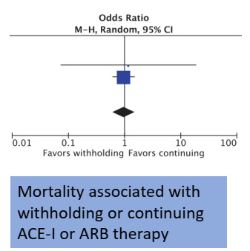
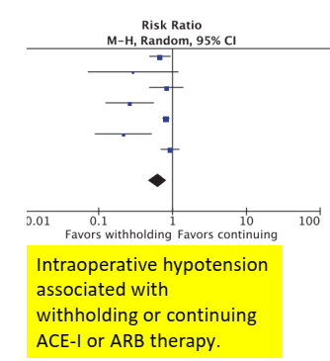
This meta-analysis did not demonstrate an association between perioperative administration of ACE-I/ARB and mortality or MACE. It did, however, confirm the current observation that perioperative continuation of ACE-I/ARBs is associated with an increased incidence of intraoperative hypotension

Slide 40
Continue/discontinue
We individualize the decision to continue or discontinue ACE inhibitors based on the indications for the drug, the patient's blood pressure, and the type of surgery and anesthesia planned.
For most patients, we usually withhold them on the morning of surgery. However, when the indication is for heart failure or poorly controlled hypertension, we continue them to avoid further exacerbation of these conditions.

Slide 41
Diuretics
There is no consensus on whether diuretics should be discontinued prior to elective surgery .Our approach depends upon the reason for diuretic use and on an individual patient's history.

Slide 42
We advise patients who are taking diuretics for hypertension to hold the medication on the morning of surgery. Diuretics may theoretically increase the risk of intraoperative hypotension, it is reasonable to hold the medication for this reason.

Slide 43
For patients with well-controlled heart failure and stable volume status, we generally recommend holding the morning dose of diuretic on the day of surgery.
For patients with heart failure in whom fluid balance has historically been more difficult to control, we recommend continuing the diuretic without interruption.

